Slide 1


Too Busy for Risk? Measuring the Distraction Effect of March Madness on Financial
Shang-Yi(Joe) Lin
Risk Practice 4/23/2025

Slide 2
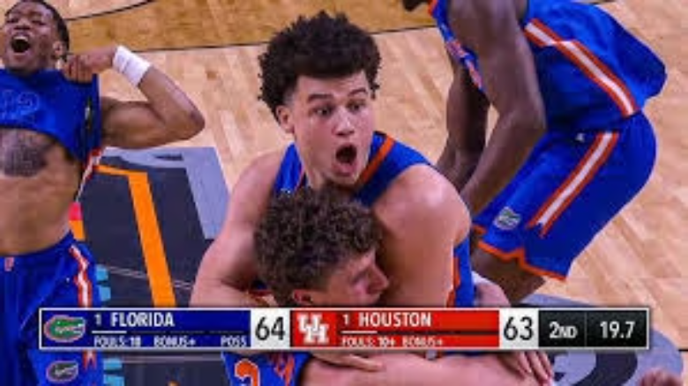
Research Motivation
Video Reference
https://www.youtube.com/watch?v=3Tf_Mhh61n0
The 2025 NCAA Men's Basketball Tournament became the most-watched since 1993, with an average of 9.4 million viewers per game.
This shows how popular the tournament is in the United States and why it can strongly affect investor attention.

Slide 3
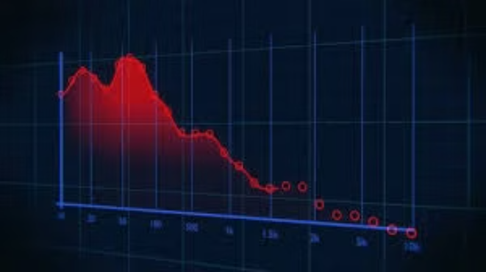
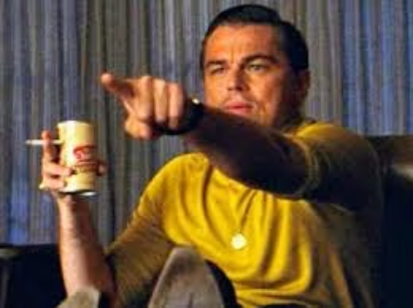
Research Motivation
Distracted Investors
Risk Prediction Errors
During March Madness, millions of people in the U.S. are watching college basketball.
If investors are distracted, it may lead to mistakes in risk predictions, such as Value at Risk (VaR) models failing more often.
Some investors might be so focused on the games that they don't pay enough attention to the market.

Slide 4
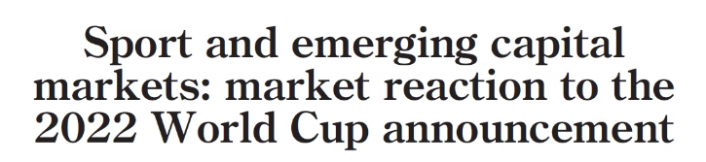

Who did this before? (reference)
1
FIFA World Cup Impact
Even in the U.S., where soccer is not the top sport, the FIFA World Cup caused stock returns to drop.
This suggests that global sports events can distract investors and affect risk patterns.
2
Emerging Markets Reaction
Emerging markets reacted strongly to the announcement of hosting the World Cup.
Shows that non-economic events can influence investor sentiment and trigger abnormal returns, especially when national pride is involved.

Slide 5
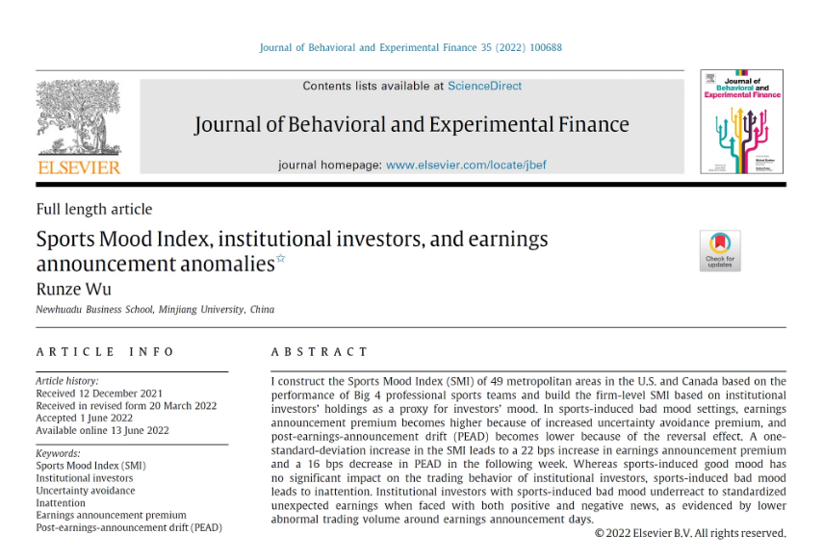
My Method is Inspired by Wu (2022)
How I apply this idea:
Instead of earnings reports, I focus on risk prediction failures (VaR violations). I use March Madness as a major sports event to test if attention loss or mood effects can lead to higher VaR model failure rates, especially for related companies.
Based on Wu (2022)
Wu created a Sports Mood Index to measure how sports outcomes influence investor behavior. He found that bad moods caused by sports losses make institutional investors trade less and underreact to earnings reports.

Slide 6








Adapting Wu (2022): From Mood to Risk Forecasting Errors
Sports Outcome (Win/Loss)
Wu (2022)
Investor Mood (Good/Bad)
Institutional Trading Behavior
Earnings Reaction (Abnormal returns)
March Madness Game Day
This Project
Investor Distraction
Risk Monitoring Lapses
VaR Violations ↑

Slide 7
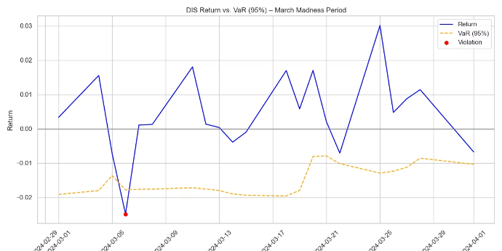
How I Measure Risk Model Failure: 95% Quantile VaR
Calculate VaR
I use a rolling 10-day quantile to estimate Value at Risk (VaR) at the 95% confidence level.
This means: "What is the 5th percentile return over the past 10 trading days?"
Identify Violations
If the actual return is lower than the VaR, it means the model failed to anticipate this drop.
Each time this happens, I count it as a VaR violation.
Track During March Madness
I track how often this happens on March Madness game days.

Slide 8
Defining Treatment vs. Control
Group
Company
Why it's here
Treatment
DIS
ESPN airs March Madness games
Treatment
DKNG
Betting spikes during the tournament
Treatment
PARA
CBS Sports is a main broadcaster
Treatment
COF
Capital One is an official sponsor
Control
MSFT
Not directly involved in the tournament
Control
JNJ
No promotional tie to March Madness
Control
WMT
Unrelated consumer retail
Control
V
Not a known sponsor or advertiser

Slide 9
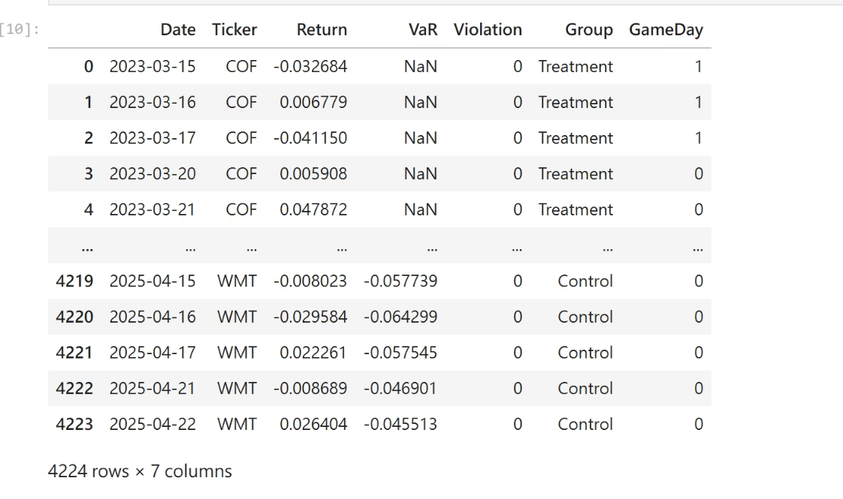
Defining GameDay
2023
2024
2025
Tournament Period
Tournament Period
Tournament Period
March 14 – April 3
March 19 – April 8
March 18 – April 7
I define GameDay = 1 if the trading day overlaps with any NCAA tournament round.

Slide 10
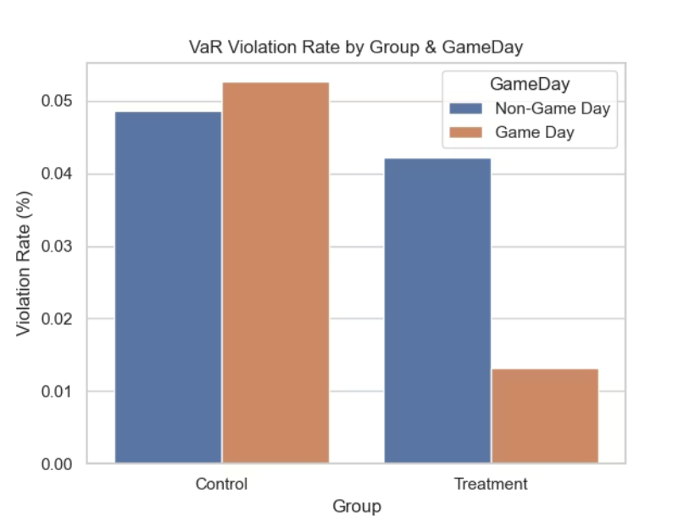
Are VaR Models More Likely to Fail on Game Days?
Findings:
In the Control group, VaR violation rates are slightly higher on game days.
In contrast, Treatment stocks show significantly fewer violations during March Madness.
Interpretation:
The result is not what we expected. It suggests that companies involved in March Madness may get more attention or risk control during the tournament, rather than being ignored by distracted investors.

Slide 11
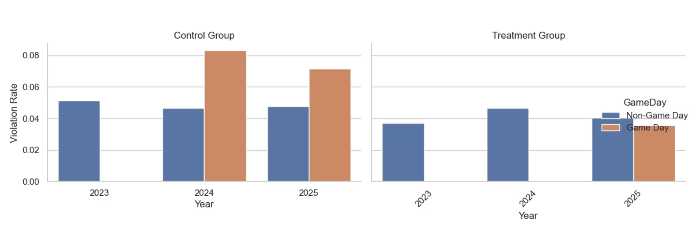
Is the Pattern Consistent Across Years?

Slide 12
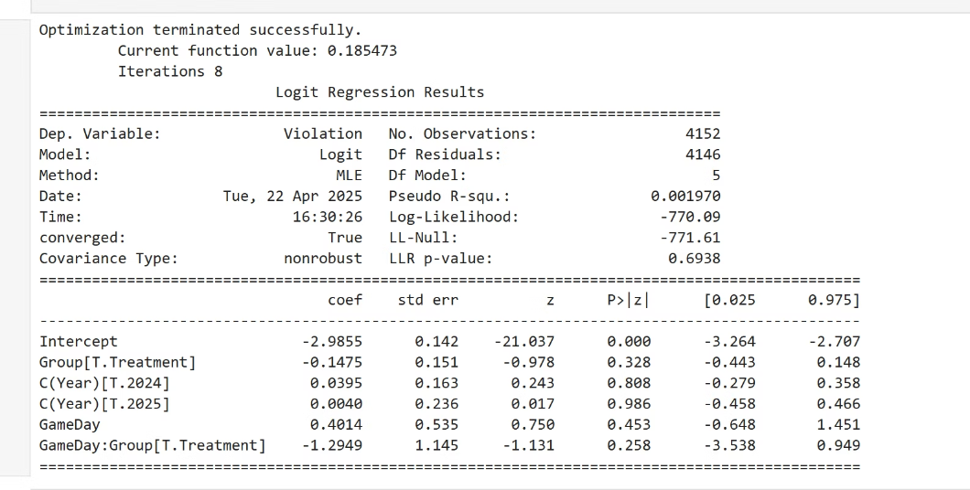
Logit Regression Confirms the Trend (But Not Significant)
We run a logistic regression to control for year effects and test the interaction between GameDay and Treatment group.
❗ The interaction term is negative, suggesting fewer violations for Treatment stocks on game days. ❌ However, the result is not statistically significant (p = 0.258).

Slide 13
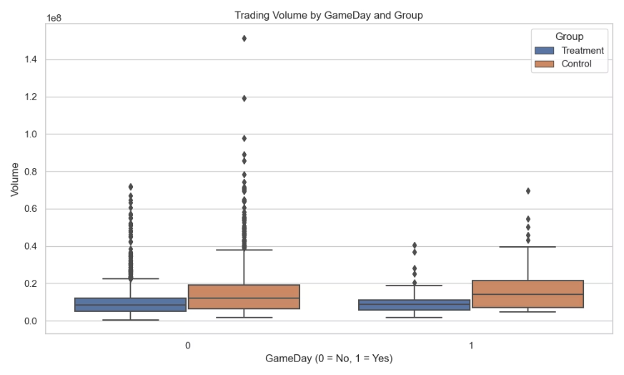
Is There More Attention on Game Days? (Volume Test)
Attention Measurement
We use daily trading volume as a proxy for investor attention.
Volume Distribution
The boxplot shows volume distributions on game days vs. non-game days for both groups.
Key Finding
There has been no significant increase in trading activity for companies related to the tournament.

Slide 14
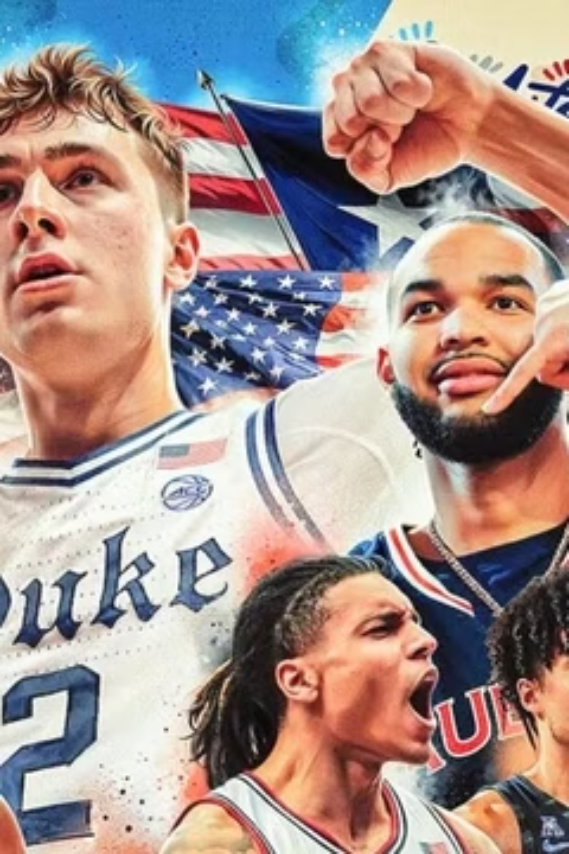



Revisiting Our Hypothesis
Initial Expectation
Actual Finding
We thought there would be more Value-at-Risk (VaR) violations for tournament-linked firms during March Madness because investors might be distracted.
However, our results show lower violation rates for these companies.
Potential Explanations
Several factors may explain this:
- Treatment selection is fundamentally challenging: Unlike studies that use geographic proximity to define investor exposure (e.g., local sports teams and nearby firms), our approach relies on sponsorship or service linkages, which mostly involve large, well-diversified firms.
- Large firms may have more stable trading patterns and conservative VaR models, making violations less likely.
- And for these companies, tourment should bring them a positive impact, not a loss!

Slide 15
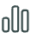


Limitations & Future Directions
Limitations
📊 Sample size is relatively small: Only 3 years of NCAA tournament data, and a limited number of trading days per year.
Future Work
⚖️ Imbalanced groups: The number of control firms is much larger than that of treatment firms, since most sponsors are big companies and there are only a few of them. This imbalance might affect the fairness of comparison or reduce the power of regression tests.
Use event study methodology on upset games or dramatic finishes
Find better proxies for distraction (Google Trends, Reddit, or volume surprise)
🏢 Treatment group definition is imperfect: Based on sponsorship or commercial links rather than local investor sentiment or emotional exposure.
Expand to other large-scale events (e.g., Super Bowl, FIFA World Cup)
Inspired by Wu’s use of local investor exposure, a powerful extension would be to redefine treatment firms based on geographic proximity to NCAA schools.
🧮 Simplified VaR model: We used historical quantile estimation. More dynamic models like quantile regression or expected shortfall (ES) could provide deeper insight.

Slide 16
Poetic ending…
You set out to capture distraction with mathematics, only to find that the human mind itself is a generator of chaos. You are not measuring risk—you are staring into the abyss of human behavior.

